Slide 1
Microsoft Project 2007
Getting Started

Slide 2

Project & Project Management
What is a project
  A Project is a temporary endeavor undertaken to create a unique product, service or result
What is Project Management
  Project Management is the application of knowledge, skills, tools and techniques to project activities to meet the project requirements

Slide 3
Project Management Process Groups – An Overview
Monitoring and Controlling Processes
Initiating
Processes
Planning
Processes
Executing
Processes
Closing
Processes

Slide 4
Project Management Knowledge Areas
Scope
Management
Risk
Management
Time
Management
Procurement
Management
Project
Integration
Management
Cost
Management
Quality
Management
Resource
Management
Communication
Management

Slide 5
Scope, Time and Cost Triangle
Cost
Scope
Quality
Time

Slide 6
PM Process Groups mapping to Project 2007
Project Management
Processes
Initiating
Processes
Planning
Processes
Executing
Processes
Monitoring &
Controlling
Processes
Closing
Processes
Project Setup
WBS Creation
Updating
Actuals
Analyze and
Adjust Schedule
Evaluating
Enter Estimates
Create New
Project
Tracking Project
& Task Progress
Reporting
Dependencies
Constraints
Identify
Resources
Assign Resources
To Tasks
Notes:
Baselining

Slide 7

Objective (Workshop)
Identify the features of the Project 2007
  Identify features of Project 2007 within the scope defined in previous slide
Learn use of identified features
  Learn usages of identified features
  Do it yourself
  Clarify doubts if there is any
  Should be able to use these features in practice post this training

Slide 8
Objective (Getting Started)
Identify the elements of the Project 2007 environment
  Get familiar with Project 2007 environment.
Learn to work with Project 2007.
  Create a project plan
  Setting basic project options
  Using Templates
  Set up the project calendar

Slide 9
Get familiar with Project 2007 environment
Project 2007 product suit
What is new in project 2007
Project interface and common views
Filters, Groups and Task Drivers

Slide 10
The Project 2007 Product Suite
Provide all the features of standard 2007 and enterprise level team planning and communication features when used with project server 2007
Windows based application designed for single project manager
Project
Standard
2007
Project
Portfolio
Server
2007
Project
Professional
2007
Project
2007
Product
Suit
A portfolio management solution that helps organizations identify, select, manage and deliver portfolios that align with their strategies
provides enterprise level project collaboration, time sheet reporting and status reporting when used with project professional 2007
Project
Web Access
2007
Project
Server
2007
Provides an internet based interface to work with Project Server 2007 like timesheet entry interface.

Slide 11
What’s new in Project 2007
Interface
  Background Cell Highlighting
  Multiple Level Undo
  Change Highlighting
  Task Driver Pane
Planning and tracking
  Manage non-working time
  Cost Resources
  Budget Tracking
Reporting
  Visual Reports to Excel
  Visual Reports to Visio Professional
  Report Templates
  Desktop OLAP cube

Slide 12
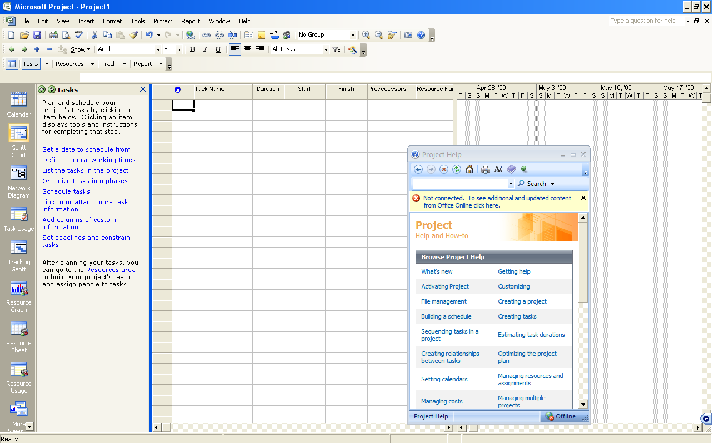
Project Interface

Slide 13
Common Views
Gantt Chart
Resource Sheet
Resource Usage
Task Usage
Calendar View
Network Diagram
Combination Views

Slide 14
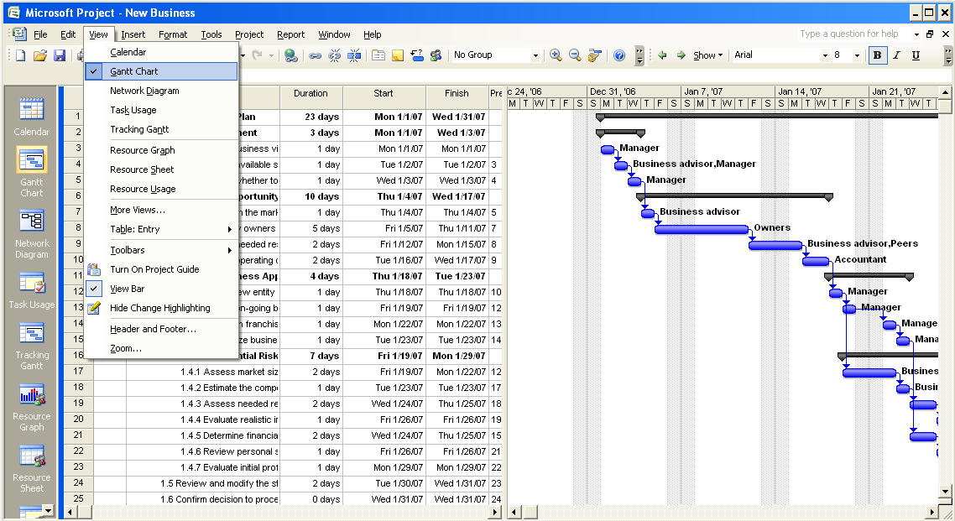
Working with views – Gantt Chart
Default View

Slide 15
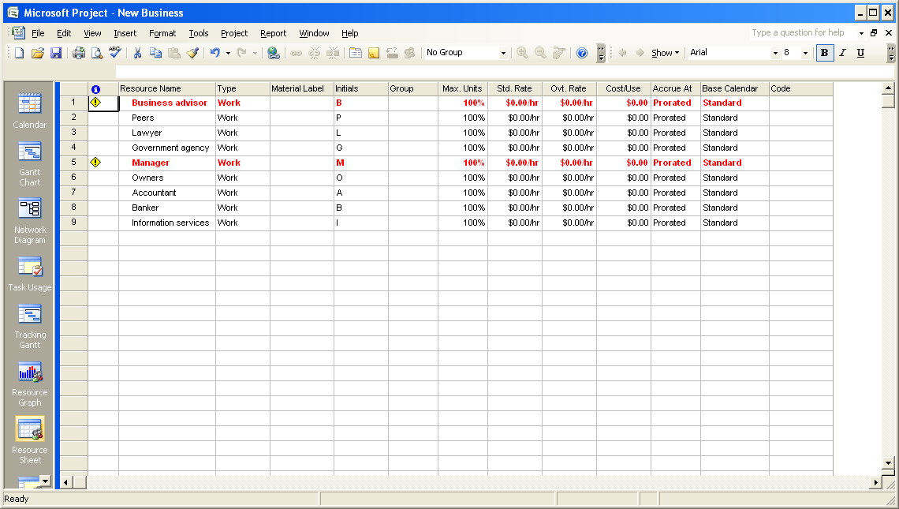
Working with views – Resource Sheet

Slide 16
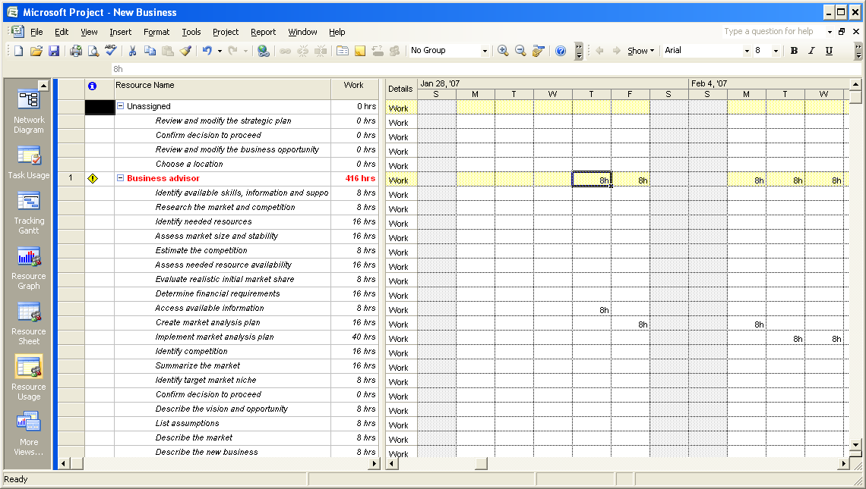
Working with views – Resource Usage

Slide 17
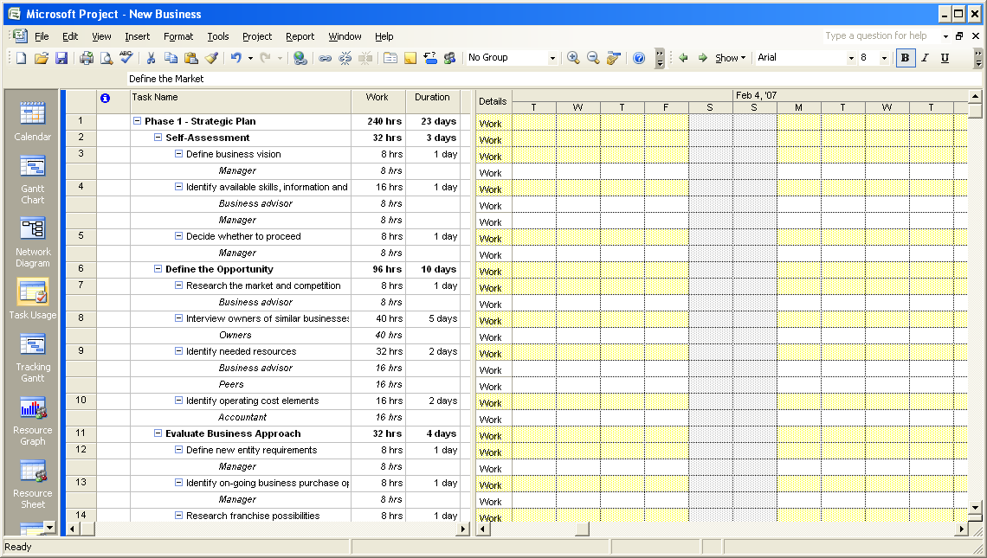
Working with views – Task Usage

Slide 18
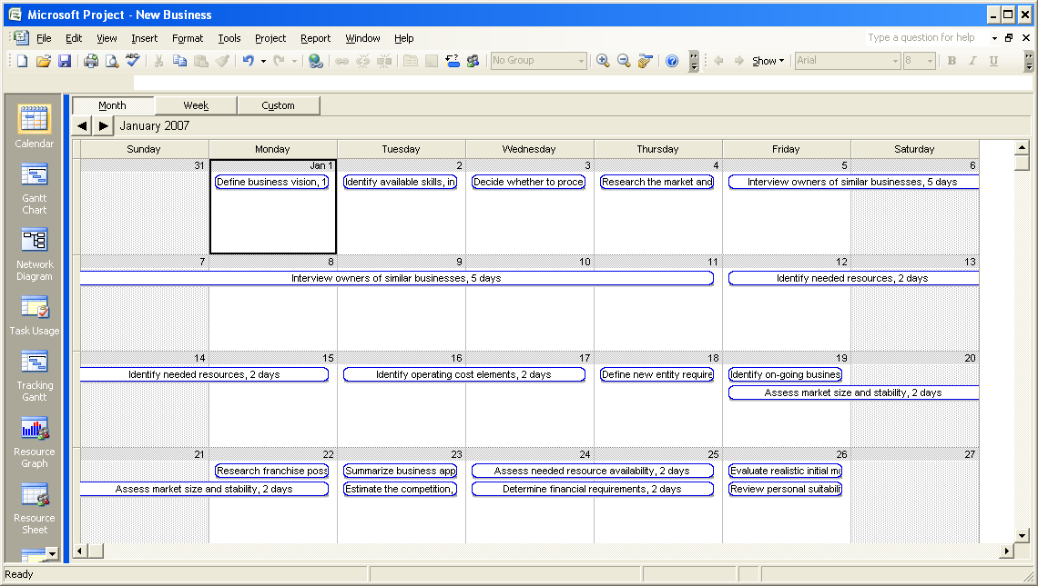
Working with views - Calendar

Slide 19
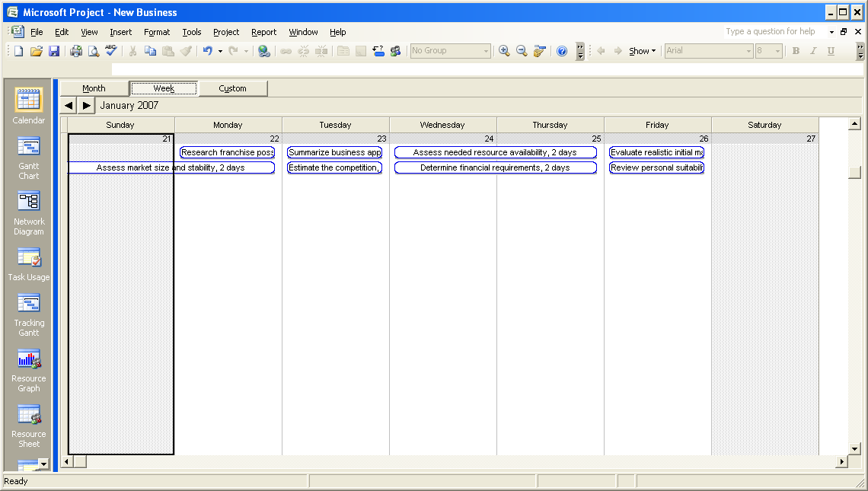
Working with views - Calendar

Slide 20
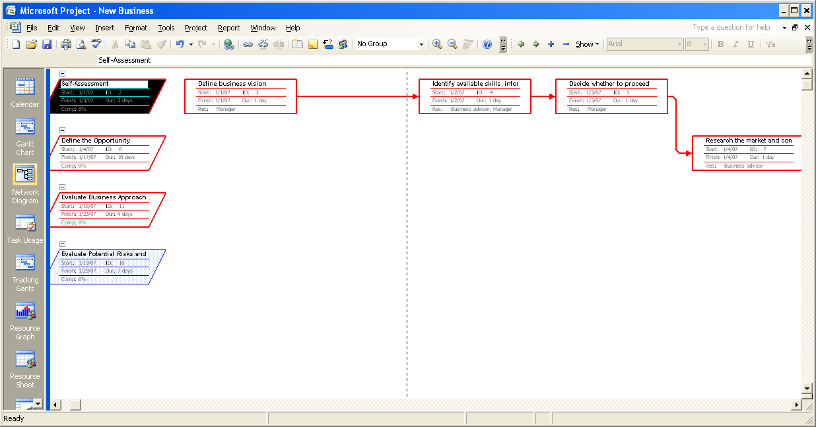
Working with views - Network

Slide 21
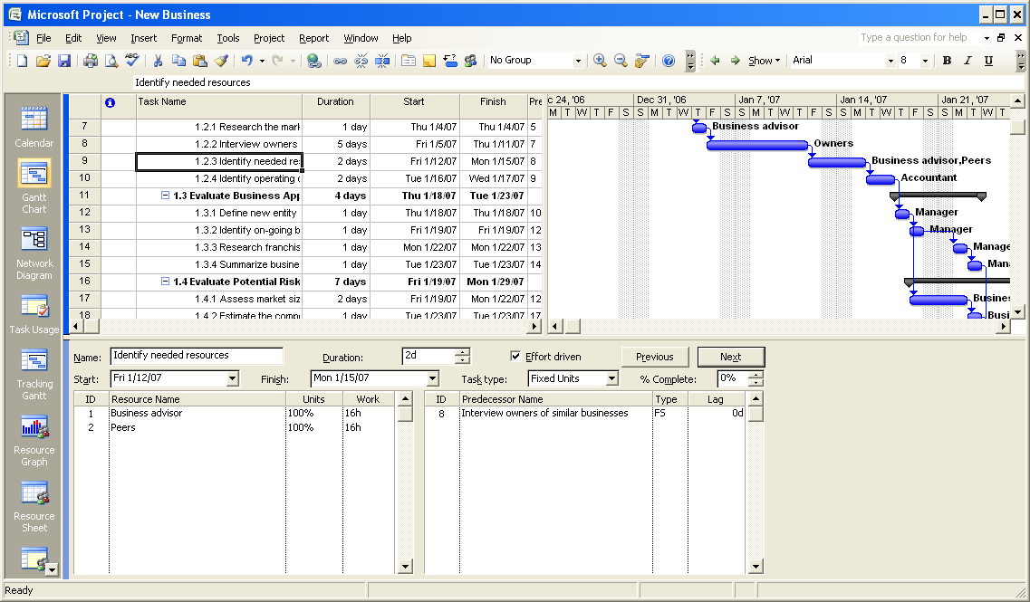
Working with views - Combination
Combination View Views → More Views → Task Entry

Slide 22
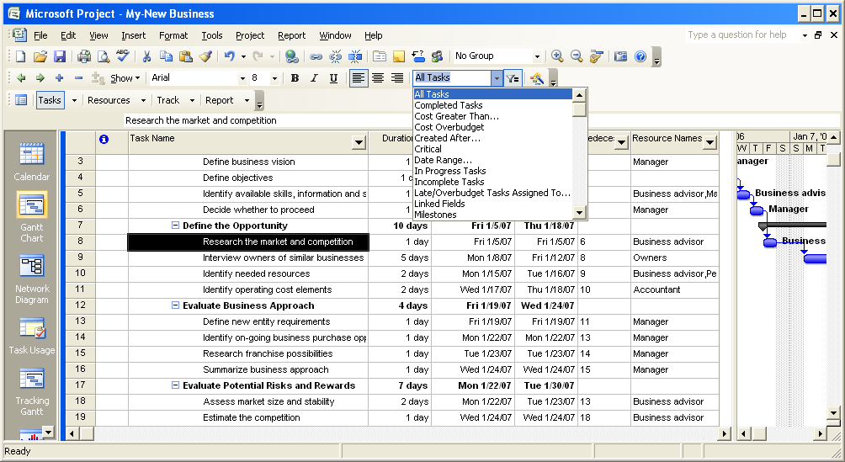
Filters

Slide 23
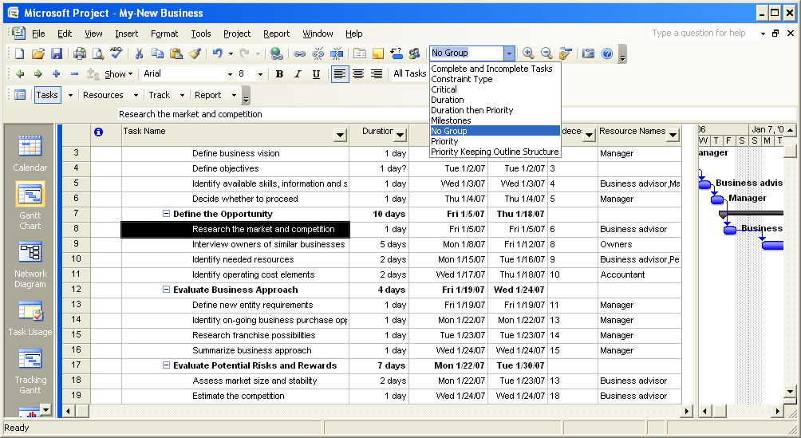
Groups

Slide 24
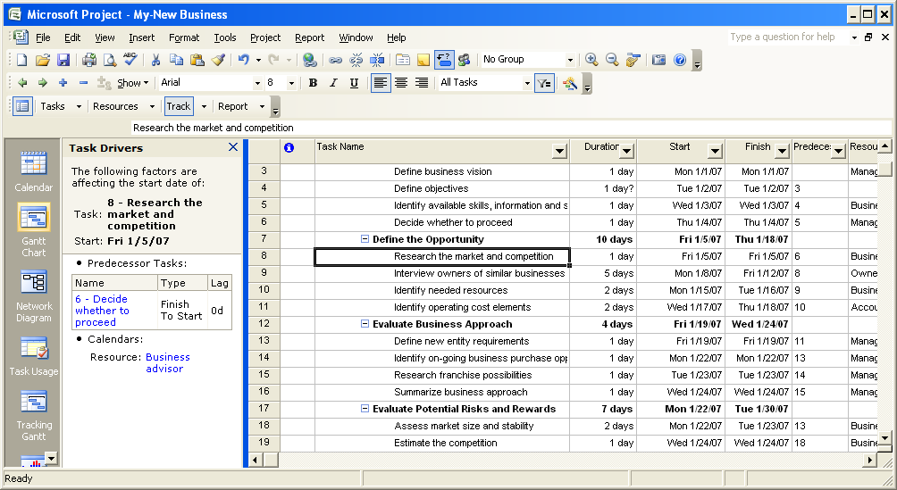
Task Drivers

Slide 25
Objective
Identify the elements of the Project 2007 environment
  Get familiar with Project 2007 environment.
Learn to work with Project 2007.
  Create a project plan
  Setting basic project options
  Using Templates
  Set up the project calendar

Slide 26
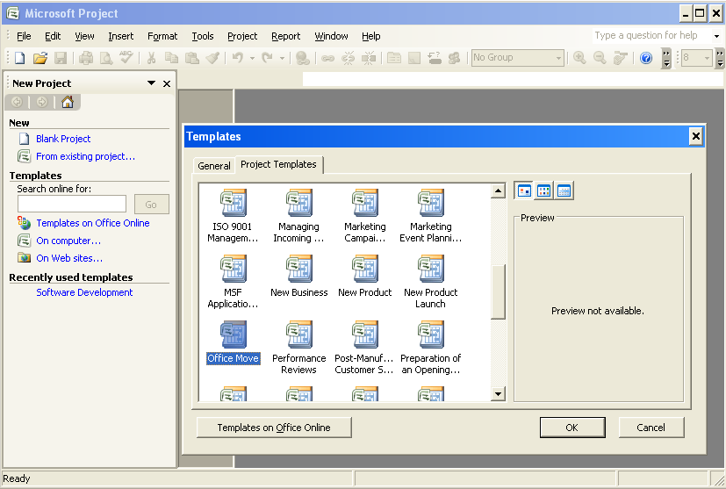
Create a New Project

Slide 27
Templates
Project 2007 provides standard templates that you can use to create your project plan quickly.
The templates include the standard tasks that need to be carried out to complete a project.
These tasks vary based on the type of project.
You can select a template that best suits the project on which you are working.
You can create your own templates
Organizations often create templates with standard high level WBS/list of activities that are common in all projects
Activity: Modify an existing template and save as My-Template

Slide 28

Create a New Project
When you create a project plan,
  You need to know start date of the project, the finish date of the project, or both.
  Project 2007 automatically calculates the other date after you specify one of the dates
  What you need
    Forward Planning – Need to specify start date
    Backward Planning – Need to specify end date
It is always a good practice to specify the start date when creating the project plan

Slide 29
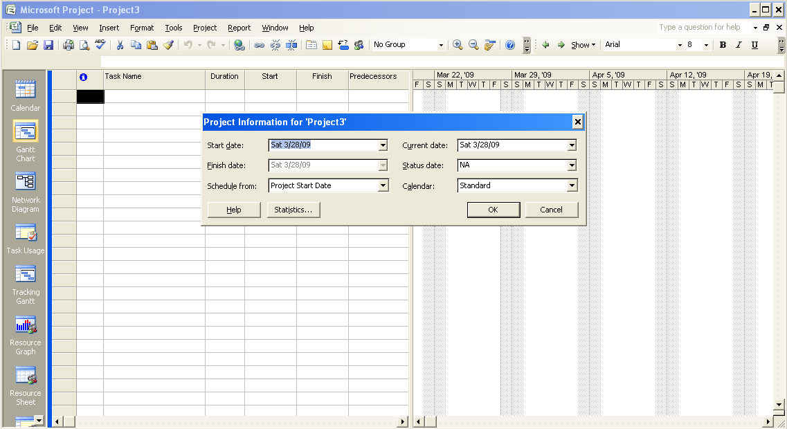
Set up Project Information

Slide 30
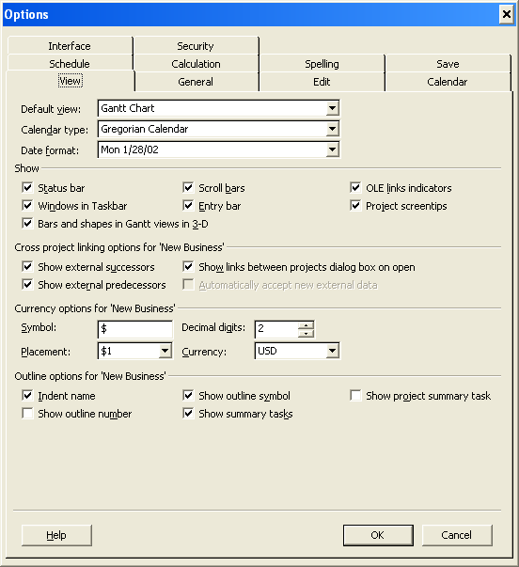

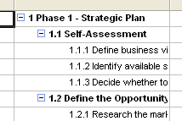
Setting working options
Specifies whether you want to display a project-level summary task, which would have an ID of 0
If checked, project name is displayed as top most summary task at level 0
Indents the names of subtasks in the Task Name column.
If you clear this check box, tasks that have subtasks are hidden from view

Slide 31
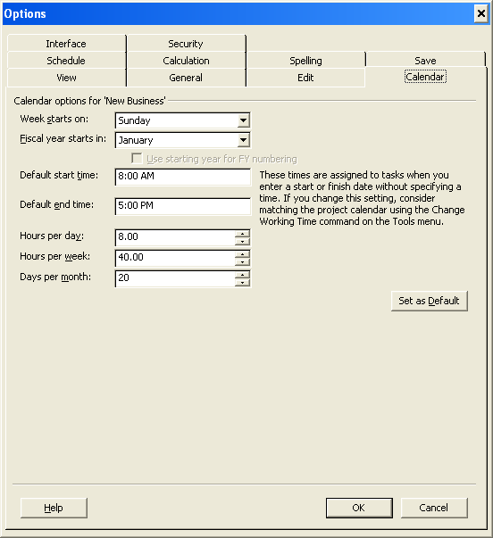
Set up Calendar Options

Slide 32
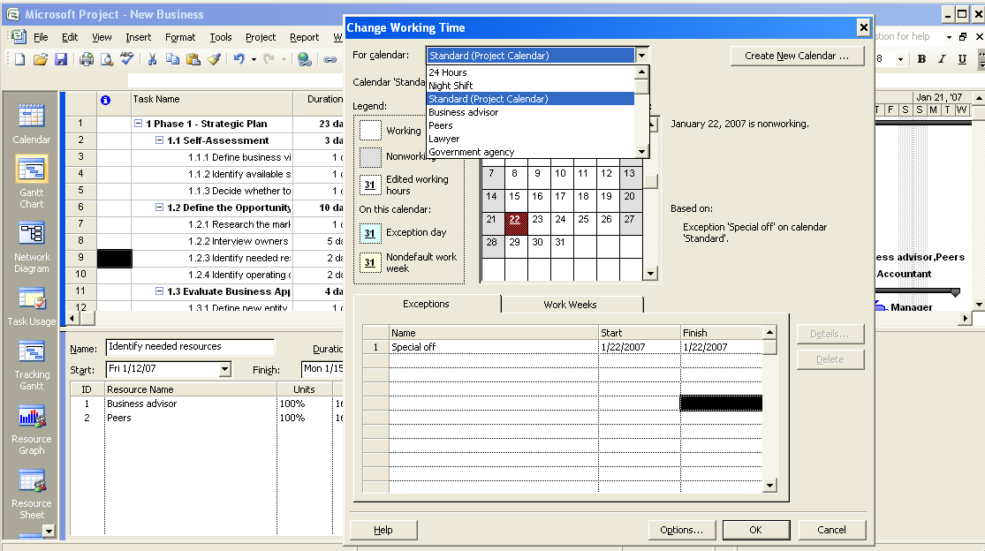
Set Up the Project Calendar
3 Base Calendar
Resource Calendars
Create a New Calendar
Enter specific non working days

Slide 33
Set Up the Project Calendar
A project calendar defines the general working and nonworking time for tasks and resources.
Steps to set up the Project Calendar
  Go to Tools → Change Working Time.
  To select a base calendar for the project, select Standard (Project Calendar). in the For calendar drop down box
  To set a nonworking day, go to Exceptions tab, click in the Name field, type Special Off and then click in the Start field.
  To set the date for the nonworking day, in the Start field, type 1/22/2007 and then press ENTER.
  Click OK to close the Change Working Time dialog box.
  To verify the change made to the project calendar, in the right pane, scroll to the right to the week indicated by Jan 22, ‘07.

Slide 34
Question
You want to create a list of resources. Which view will be most suitable
Select the one best answer.
  Gantt Chart
  Resource Usage
  Network View
  Resource Sheet
  ✓

Slide 35
Question
Which of the following feature helps you in the process of creating a new project
Select the one best answer.
  Project Information dialog box
  Template
  Planning Wizards
  New custom calendar
  ✓

Slide 36
Question
You want to see only critical tasks in your Gantt Chart view. Which of the following feature you will use
Select the one best answer.
  Template
  Groups
  Filters
  A combination view
  ✓

Slide 37
Question
You need to extend the working hours and working days for a project to finish it early. You want to set the working hours for your project as Monday to Saturday, 9.00 A.M. to 6.00 P.M., with a one-hour lunch break. Which of the following base calendars will you use?
Select the one best answer.
  24 Hours base calendar.
  Night Shift base calendar.
  Standard base calendar.
  New custom base calendar.
  ✓

Slide 38
Objective
Identify the elements of the Project 2007 environment
  Get familiar with Project 2007 environment.
Learn to work with Project 2007.
  Create a project plan
  Setting basic project options
  Using Templates
  Set up the project calendar

